Slide 1
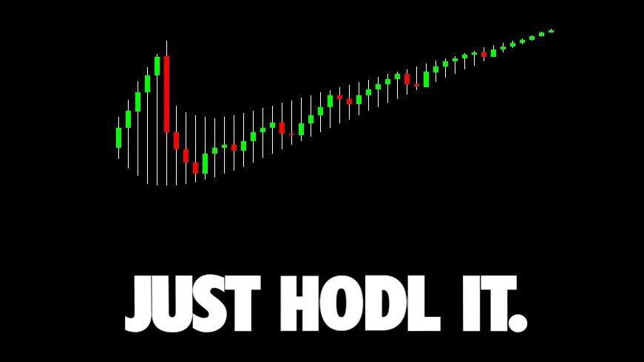
Intro to
₿itcoin & Crypto
An Educated Guess
By Sachin Meier

Slide 2
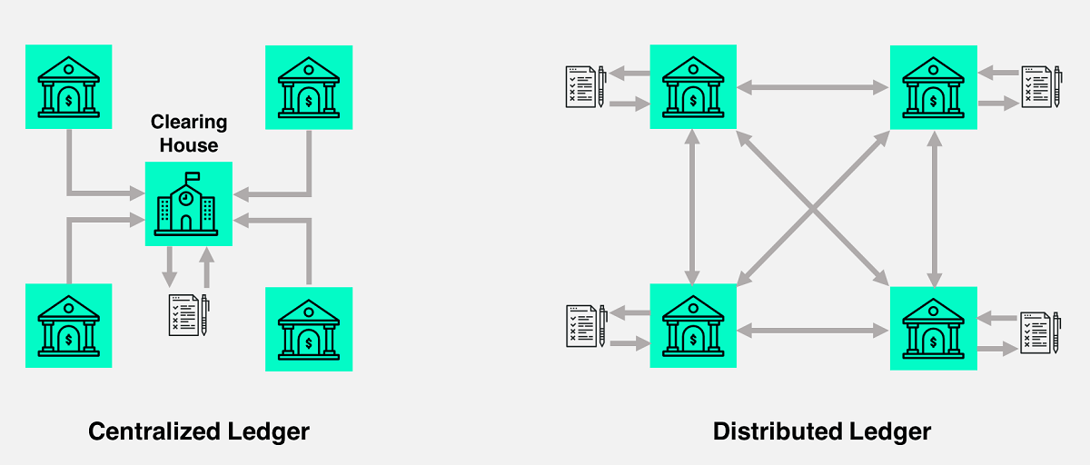
What is Bitcoin?
A Cryptocurrency
A Public Distributed Ledger
Hard Money
Sovereign Free Speech

Slide 3
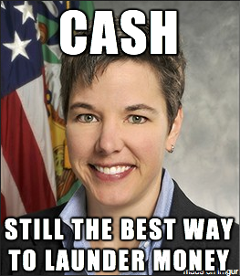
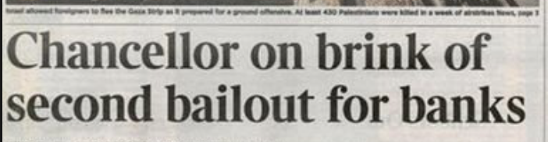
What is wrong with Fiat / Central Banking System?
Inflation (See: Cyprus, Venezuela, Zimbabwe)
Cantillon Effects
Disincentivizes Saving/Investment
Max Keiser: Fraud and Terrorism
Corporate Welfare
Remittances
20-35% Fees for immigrants to wire Money back home
Access: ~3 Billion unbanked people.

Slide 4
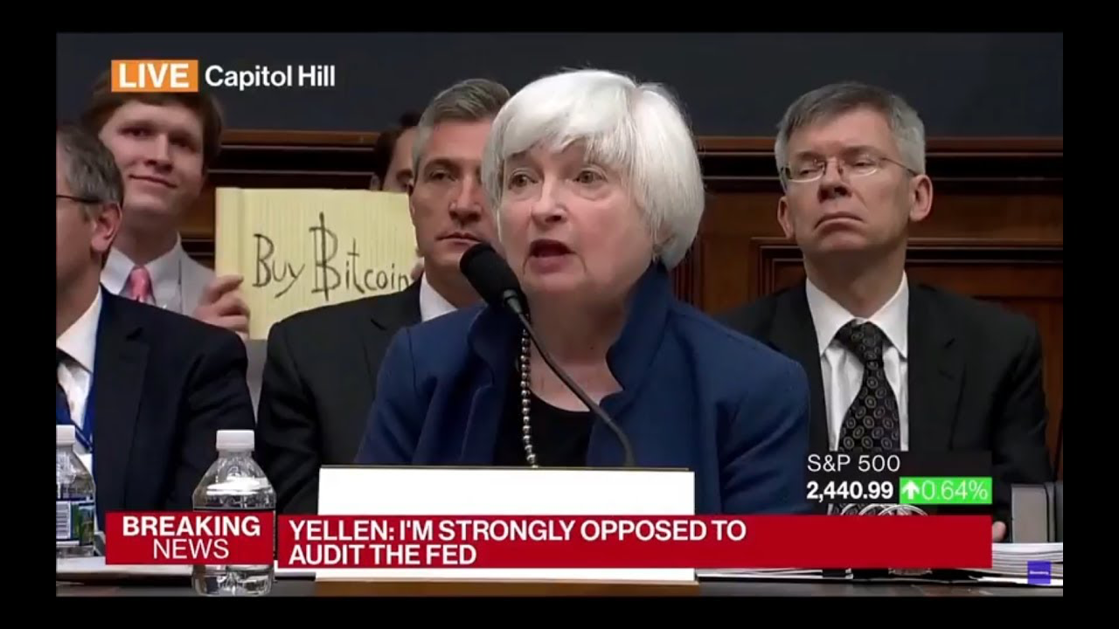

Slide 5
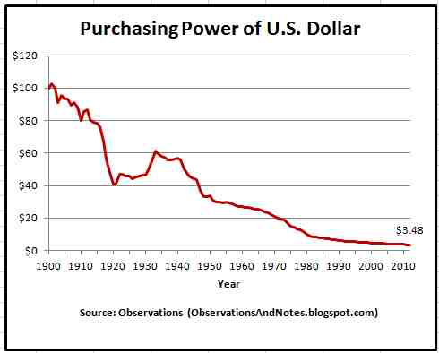
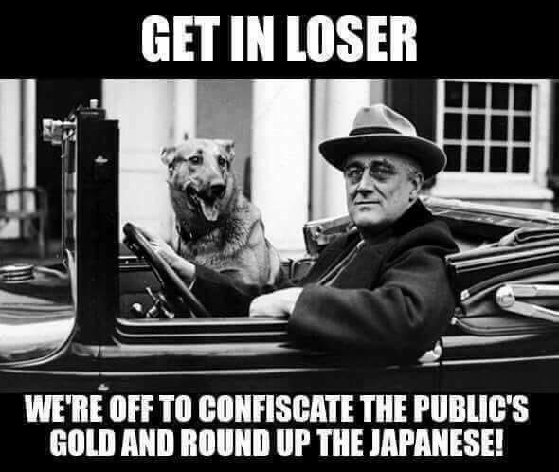
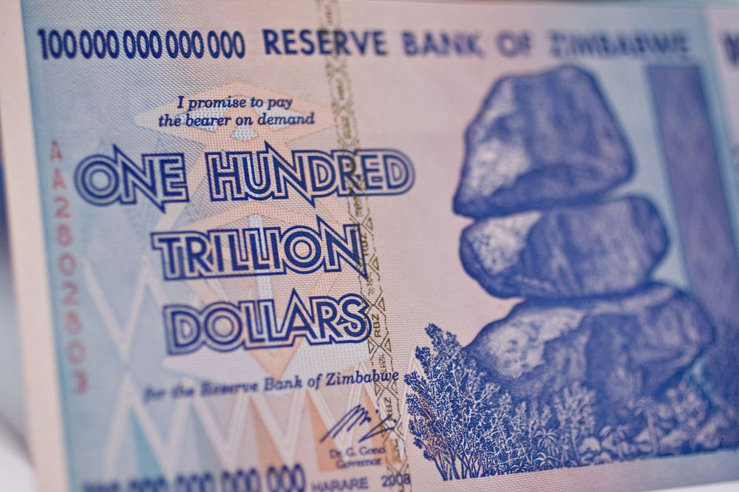
Government Money
Nigeria: 30% per year since 2009
Argentina: 22% in 2017
Venezuela: 1,000,000% since 2012
Zimbabwe: 12,750% in 2007*
US: 56% since 1971 (Bretton-Woods)
*(The Government banned measuring Inflation.)

Slide 6
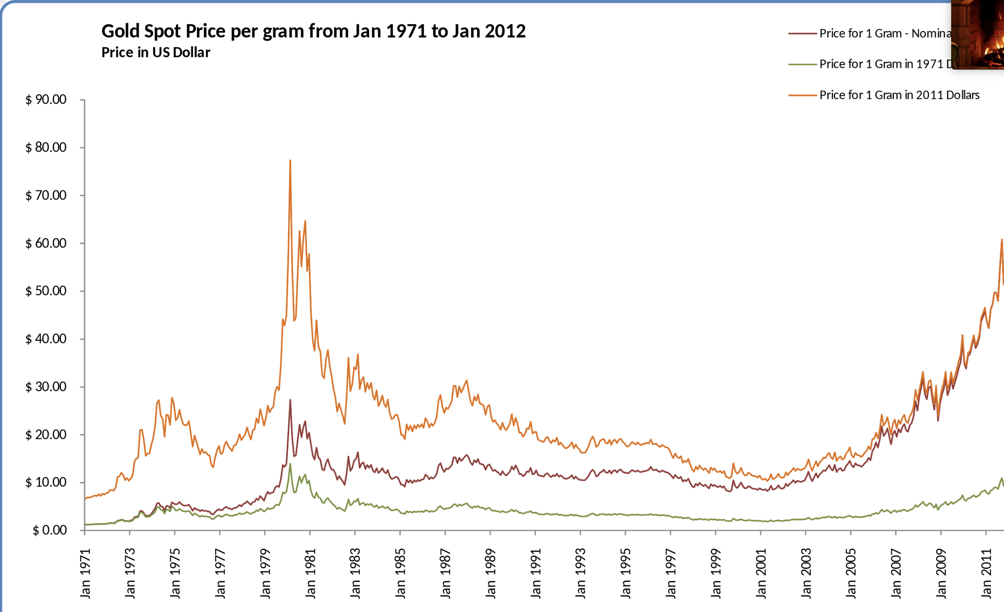
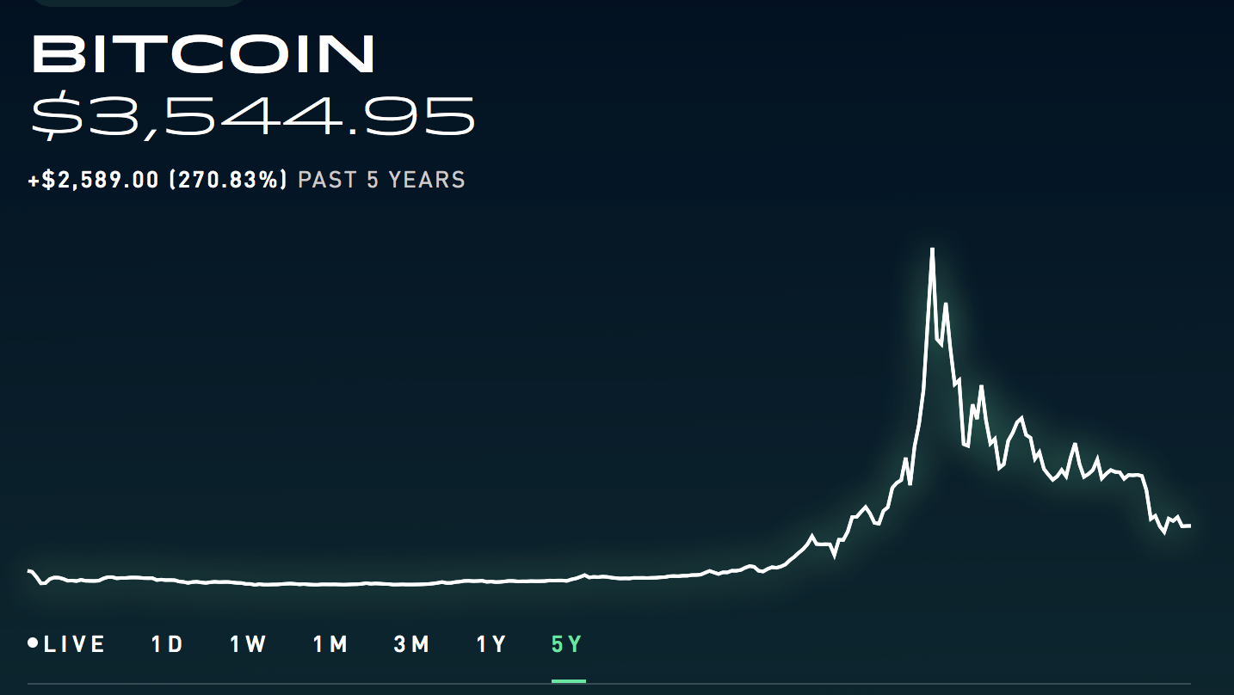
Is Bitcoin Money?
--Bitcoin is already a Store of value
(regardless of whether it’s profitable)
--Bitcoin has always been a unit of account.
Can BTC be a Medium of Exchange??
Money:
Store of value
Unit of Account
Medium of Exchange
Moon
$20,000

Slide 7
Can BTC be a Medium of Exchange?
Blockchain technology is inefficient, slow, and data-heavy. Scalability is also a problem.
BTC: 7-10 TPS
PayPal: 200 TPS
VISA: 24,000+ TPS
Solution? ⚡ Lightning Network. ⚡

Slide 8
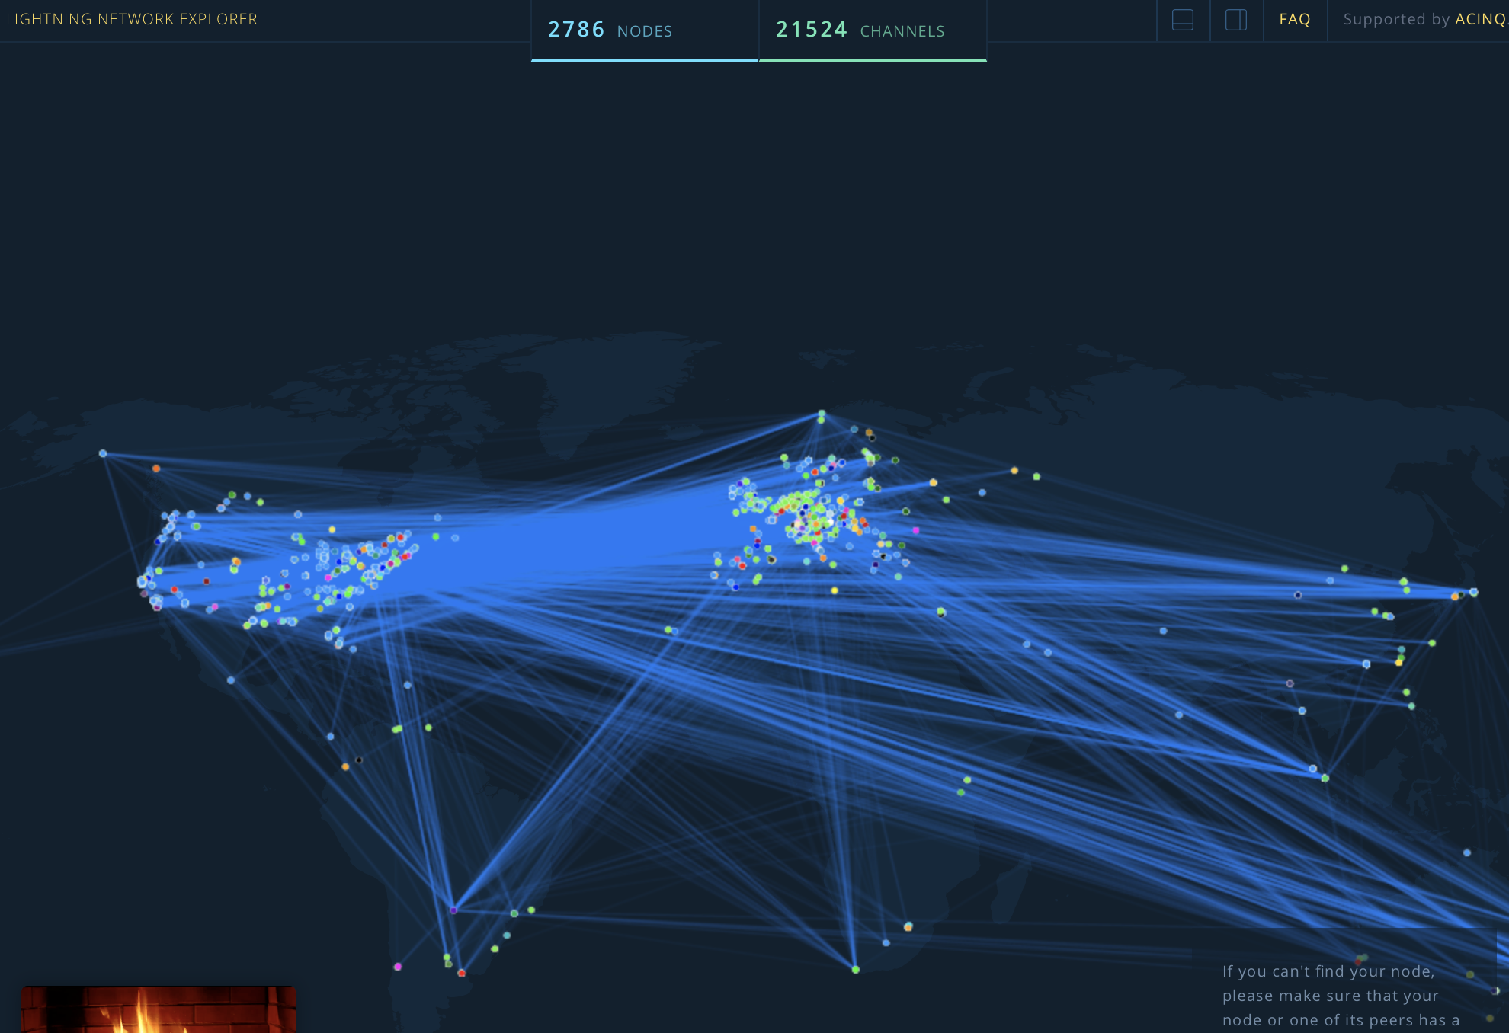
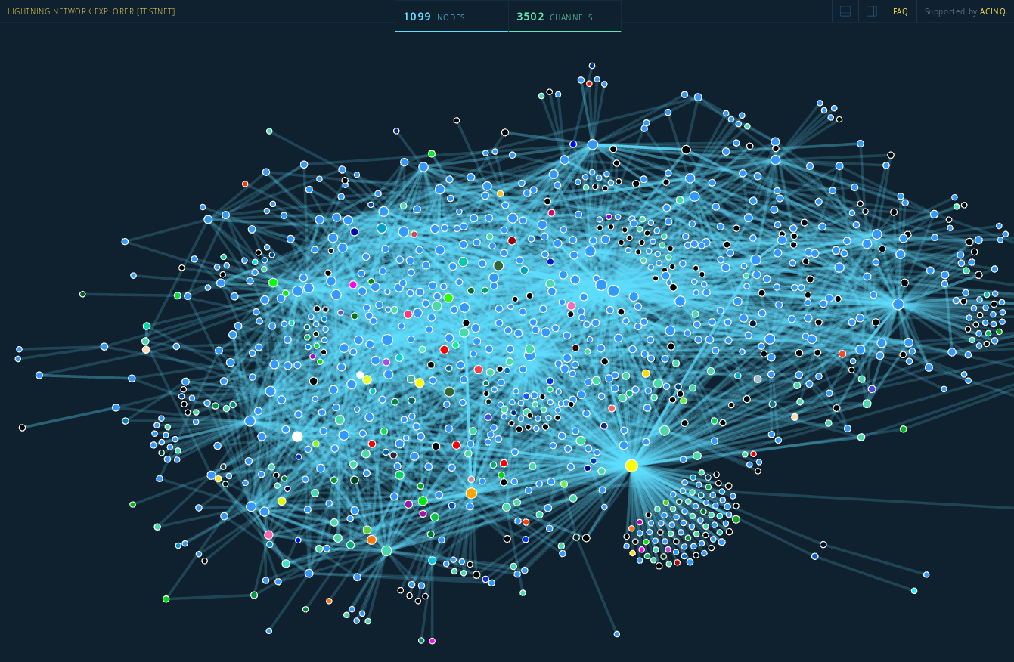
⚡ Lightning Network ⚡
Simply: A direct P2P payment system.
⚡ Truly Instant Payment
⚡ Trustless, computer-executed contracts
⚡ Infinitesimally small amounts
⚡ Even smaller fees. ~$.00001 per TX
⚡ Infinite TPS Potential
Visualization of the LN
2018: 1000 Nodes - 3500 Channels
2019: 2700 Nodes - 23000 Channels

Slide 9
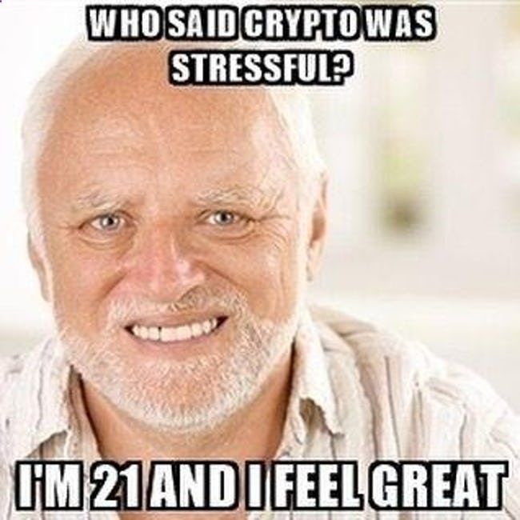
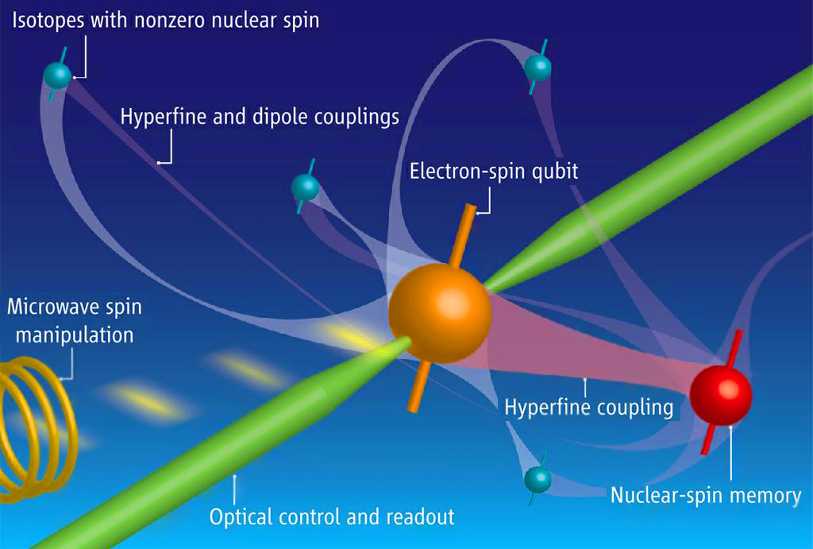
Is BTC a Scam / Will it go to Zero
Blockchain not Bitcoin
The Fiat Argument: BTC’s based on nothing
The MySpace Accusation
Deflation will impoverish people
The Government will shut it down
Warren Buffet Says so
It’s Money for Criminals and Terrorists
Quantum Computers?!?!?

Slide 10
More Resources
Bitcoin Resource List by Jameson Lopp
Bitcoin WhitePaper by Satoshi Nakamoto
Lightning WhitePaper by Joseph Poon and Thaddeus Dryja
Congressional hearing on Bitcoin 2013
Bitcoin Explained to Canadian Parliament by Andreas Antonopoulos
Twitter, Reddit, Slack, Email Lists. (For suggestions follow @mountgox101 or me)
Debate: Will Bitcoin Stay?
Erik Voorhees vs. Peter Schiff
Podcast: Noded with Pierre Rochard and Bitstein AKA Michael Goldstein
Podcast: Tales from the Crypt with Marty Bent
Books:
The Bitcoin Standard by Saifedean Ammous
Mastering Bitcoin by Andreas Antonopoulos

Slide 11
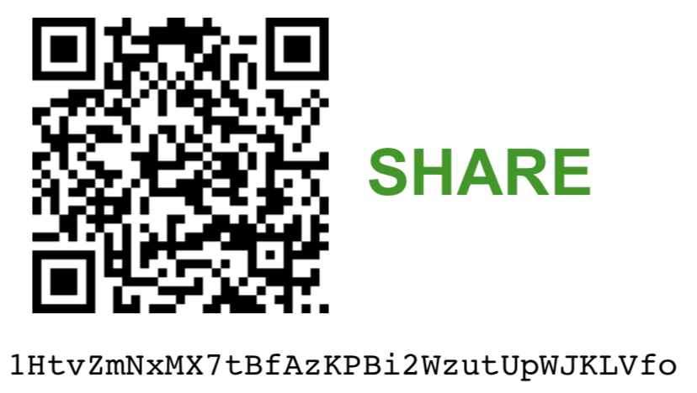
Never buy Altcoins, ICOs, etc.
Never sell Bitcoin (HODL)
Don’t use bitcoin.com
Own your own Private Keys
Run a Full Node
Don’t Pay Taxes
Don’t take Kevin Pham Seriously
Don’t take Roger Ver Seriously
Read CryptoTwitter
Read certain Reddits (not r/btc)
Read A History of Money and Banking in the US
Ask for Help, esp. on Twitter and Slack
Don’t look at the price
Backup your keys
Have a “will”
Tell your Friends
THANK YOU! Email me (spm116@georgetown.edu) with any questions.
More PowerPoints here
(https://drive.google.com/drive/folders/1AgMsxIlvEb8Vnymy5mJ5Cy8Djh6IeNKP?usp=sharing)

